Slide 1
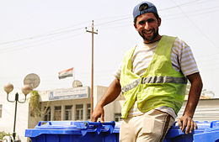
The Garbage Collector in your Neighborhood
By Helen Tross
2012

Slide 2
The grocer, the baker, and the hamburger maker… but what about the garbage collector?
He picks up all your trash. He helps everyone in your neighborhood!

Slide 3
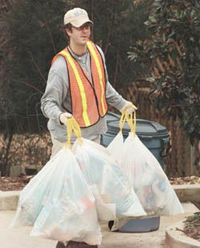
The garbage collectors wear special gear for safety. They put on a bright vest or uniform so other drivers can see them working.

Slide 4
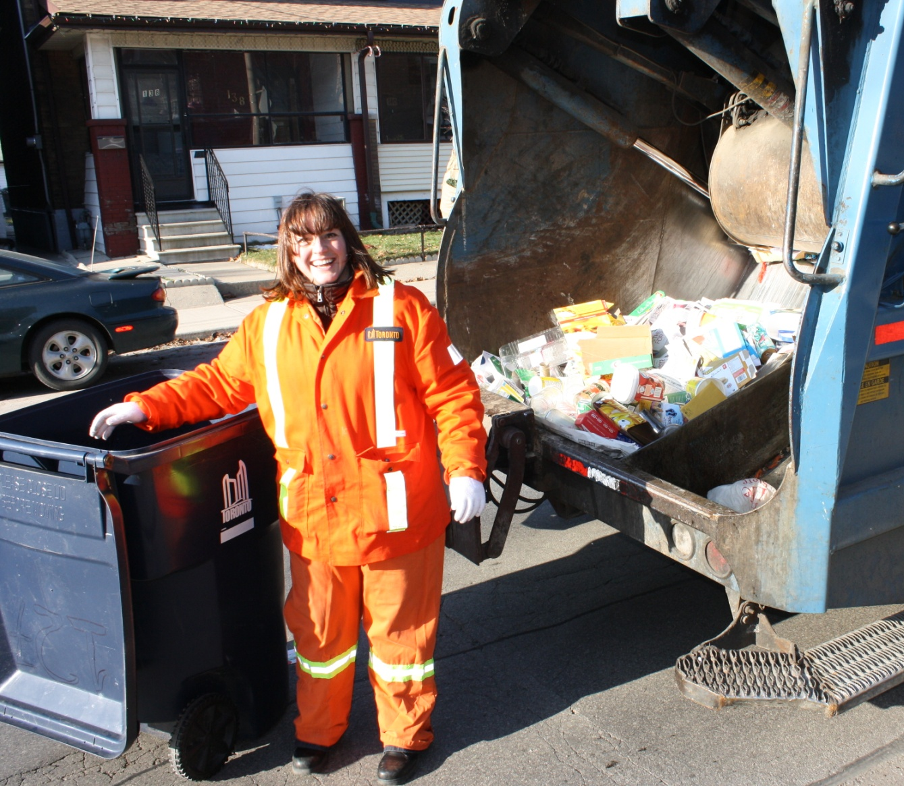
Garbage collectors always wear gloves to protect their hands from germs and sharp objects.

Slide 5
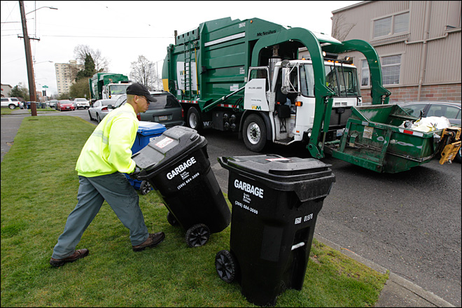
Sometimes garbage collectors wear a hat to protect them from the sun.
What equipment does the garbage collector use? Study the photograph.

Slide 6
It’s the super–duper garbage truck! It has arms to lift trash. It has large windows so the driver can see everything! It has many huge wheels. What else do you see?

Slide 7
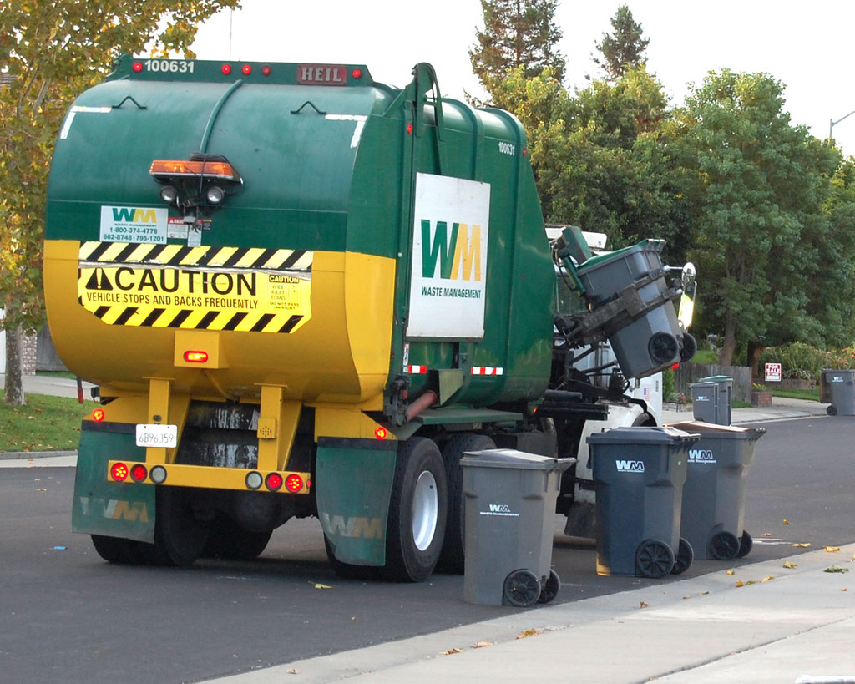
These garbage collectors are very lucky. They have big trucks that lift the trash cans into it. This is a super-duper garbage truck!

Slide 8
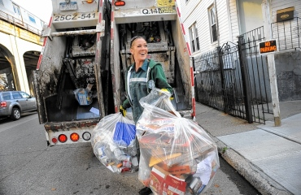
Some garbage collectors must lift the cans into the garbage truck. Their trucks do not do as much of the work for the garbage collector.

Slide 9
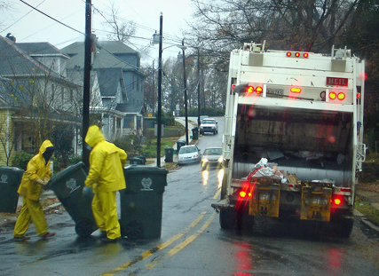
Rain, snow, or heat does not stop the garbage collectors. They work in all kinds of weather. How is the uniform of these garbage collectors different?

Slide 10
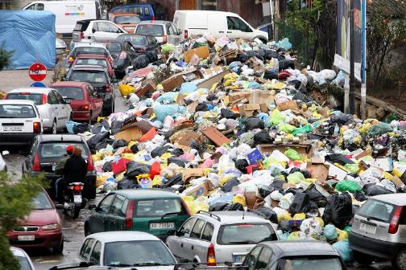
If the garbage collector does not pick up your trash, you will have a big mess! Why is this dangerous?

Slide 11
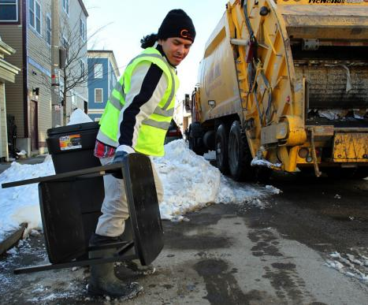
All neighborhoods need garbage collectors! They keep the neighborhoods clean for you and me.

